Slide 1

Trends in Earthquake Activity (1900-2025) in the Conterminous U.S: An Analysis of Temporal and Spatial Patterns
Presented by Muhammad Sualeh Alam
Student ID: tz3502
Course: STAT 651

Slide 2
Data Description
The original dataset had 22 columns and 3439 rows of earthquakes with Magnitude > 4.5 in conterminous US States, after cleaning the data, we are focusing now on only 7 columns.
The dataset has earthquakes from year 1900 to 2025 capturing all earthquakes with M > 4.5.
Source of the dataset: USGS
time: Timestamp of the earthquake event in ISO 8601 format
latitude: Latitude of the earthquake’s epicenter in decimal degrees.
longitude: Longitude of the earthquake’s epicenter in decimal degrees.
depth: The depth of the earthquake's epicenter below the Earth’s surface, measured in kilometers.
mag: The magnitude of the earthquake, measured on the Richter scale or other magnitude scales like mb (body-wave magnitude).
place: It is the location of the earthquake, usually including the distance and direction from a known city or landmark.
type: This is whether the event was a main earthquake, aftershock, or another type of seismic event.

Slide 3
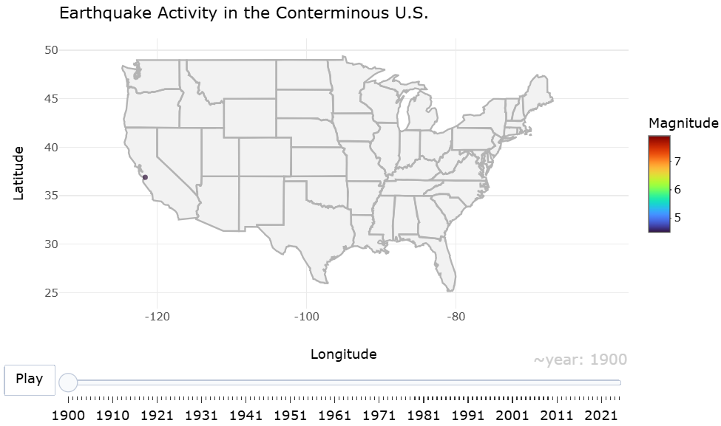
How has the spatial distribution of moderate earthquakes evolved across the U.S. from 1900 to 2025?
Observation:
The graph shows the spatial distribution of earthquakes across the U.S. on the map. Certain regions are more frequently affected by these earthquakes, such as California and Mexico (especially the West Coast area).

Slide 4
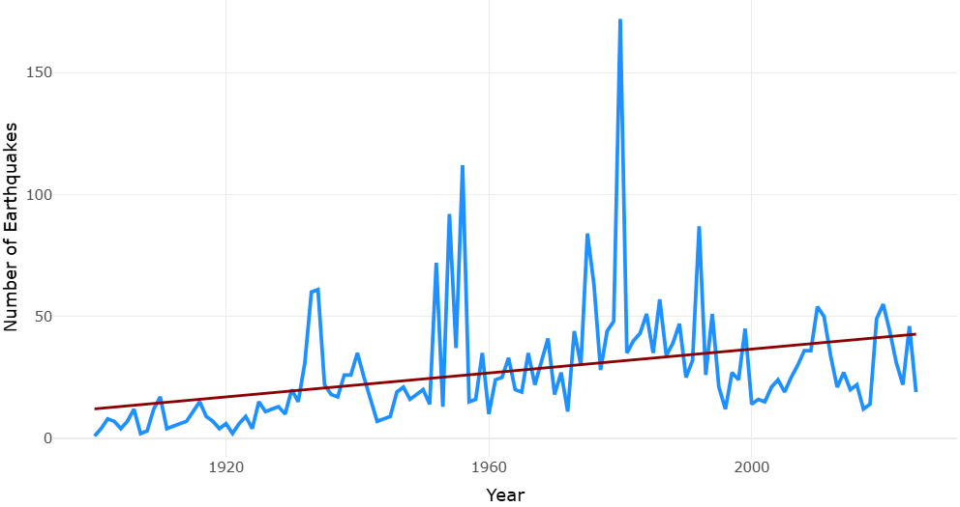
How has the frequency of 5.5 Magnitude earthquakes in the U.S. changed over time from the 1900s to the 2020s?
Observation:
The frequency of earthquakes in the U.S. shows an overall increase, but this increase is likely due to a combination of external and environmental factors.

Slide 5
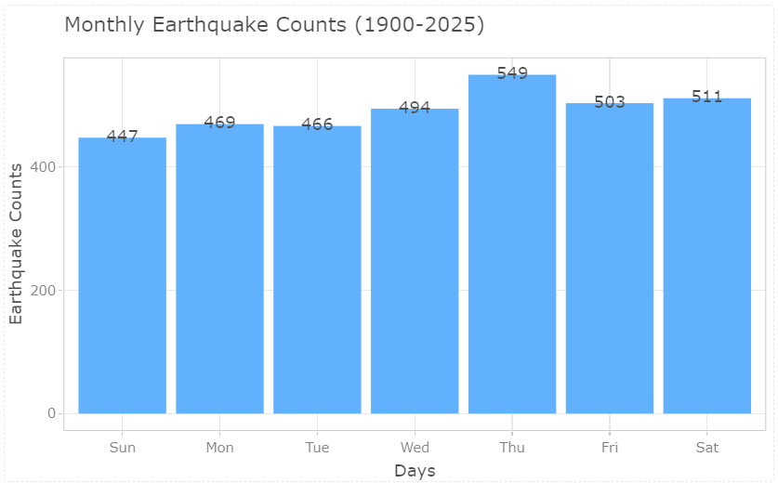
Which day of the week sees the most earthquake activity?
Observation:
Based on the bargraph, Thursday is the day with the highest earthquake activity, with 549 earthquakes recorded. It is consistently the most seismically active day of the week, followed closely by Saturday and Wednesday. Sunday tends to have the lowest earthquake counts, suggesting that seismic activity is slightly lower on Sundays.

